Slide 1
Engaging Families: A Systems Thinking Approach August 23, 2012
M. Elena Lopez, Senior Consultant
Harvard Family Research Project
http://www.hfrp.org
Prepared for WETA Webinar on Parent Engagement: Three Perspectives

Slide 2
Context
One in six children who are not reading at a proficient level by third grade do not graduate high school on time.
Source: Donald J. Hernandez (2011). Double jeopardy: How third-grade reading skills and poverty influence high school graduation. Baltimore: The Annie E. Casey Foundation.

Slide 3
“The problems we have created in the world today will not be solved by the level of thinking that created them.”
Albert Einstein

Slide 4
Systems thinking: a new level of thinking
Seeing the whole picture
Exploring connections
Designing for the long-term
Source: Linda Booth Sweeny & Dennis Meadows (2010). The systems thinking playbook. White River Junction, VT: Chelsea Green Publishing.

Slide 5
Family engagement in children’s literacy development: Essential system elements
Leadership
Professional Capacity
Organizational Climate
Teaching and Learning
Family Partnership
Community Partnership
Adapted from: Bryk, Anthony S., Sebring, Penny B., Allensworth, Elaine, Luppescu, Stuart & Easton, John Q. (2010).Organizing Schools for improvement: Lessons from Chicago. Chicago: University of Chicago Press.

Slide 6
Leadership
How does leadership establish the tone and processes to engage underserved families?
How does leadership support staff to engage underserved families?
How does leadership partner with educational, business and community organizations to reach underserved families?

Slide 7
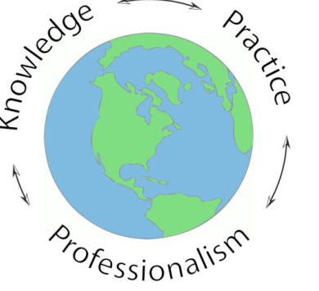
Professional capacity
Does an organization hire staff that have the dispositions and skills to engage different types of families?
How does professional development enable staff to develop strong family relationships?
What opportunities do staff have for learning and continuous improvement?

Slide 8
Organization climate
Is the physical place safe and welcoming?
What are the opportunities for parent peer interaction?
How does an organization’s activities respect the cultural and linguistic backgrounds of families?

Slide 9
Teaching and learning
How well does the curriculum/reading program motivate and meaningfully engage children?
How are families encouraged to build on home literacy practices with their children?
What opportunities exist for parents to develop their language and literacy skills?

Slide 10
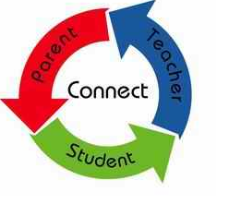
Family partnership
How are outreach efforts tailored to align with the interests and needs of families?
What does the organization or program do to build trusting relationships?
What are the opportunities to give families a meaningful voice in promoting literacy development-- for their child and for the community?

Slide 11
Community partnership
To what extent do community partners coordinate their outreach efforts to underserved families?
Are promising practices to reach underserved families shared among community agencies?
What is the desirability and feasibility of developing a community wide integrated literacy program for underserved families?

Slide 12
Conclusion
Systems approach
Focus on the whole rather than parts
Opens up new possibilities for creating change that works
Affords staff, parents and community voices to shape action steps

Slide 13
http://www.hfrp.org/
Family Engagement in Early Childhood Education
http://www.hfrp.org/early-childhood-education
Storybook Corner: Using Children’s Storybooks to Promote Family Engagement
http://www.hfrp.org/family-involvement/projects/family-involvement-storybook-project-completed-project/storybook-corner/tomasito-s-mother-comes-to-school
Family Literacy
http://www.hfrp.org/publications-resources/browse-our-publications/family-literacy-a-review-of-programs-and-critical-perspectives
FINE Newsletter: New Developments in Early Childhood Education
http://www.hfrp.org/family-involvement/fine-family-involvement-network-of-educators/fine-newsletter-archive/march-fine-newsletter-new-developments-in-early-childhood-education

