Slide 1
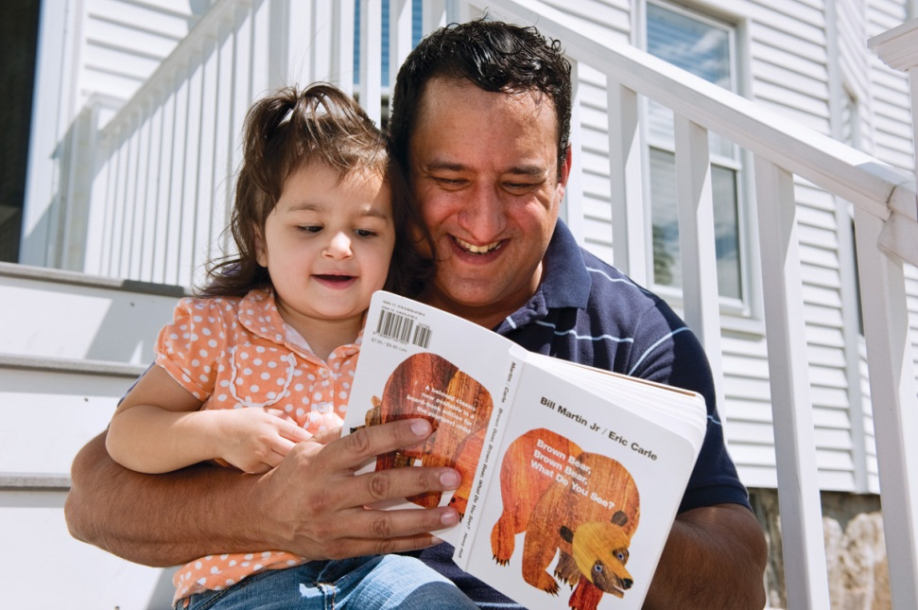
Educating Our Children: The Critical Role of Parents and How to Effectively Engage
September 2012

Slide 2
The Need
“A parent’s contribution to their child’s early development is as strong an influence as early education.”*
“Children who are poor readers at the end of first grade almost never acquire average-level reading skills by the end of elementary school.”**
34% of all U.S. 4th graders can read proficiently; 17% of all 4th graders who qualify for free lunch can read proficiently. ***
“Millions of American children are growing up with risk factors that predict that they will not succeed in the world they will inherit.”****
*Morrison, F.J., Bachman H.J. & Connor C.M., 2005,Improving Literacy in America, Guidelines from the Research, Yale University Press
**Torgeson, J. Avoiding the Devastating Downward Spiral, American Educator, 2004
***NAEP 4th grade reading results, 2011
***Annie E. Casey 2012 Kids Count Data Book

Slide 3
Effectively Engaging Parents of
Infants and Toddlers
Strategies from
Reach Out and Read

Slide 4
School Success Largely Determined by Age 3
Basic language and communication skills are formed during a child’s first three years
Language experience before age 3 is an excellent predictor of reading ability in third grade
After 3 years of age, it is increasingly difficult to make up for differences in earlier experiences

Slide 5
Importance of Early Engagement
 | More Engaged Parents | Less Engaged Parents
Words heard per hour | 2,168 | 616
Words known by age 3 | 1,116 | 525
Words heard by age 4 | 45 million | 13 million
Letters of alphabet by 5 | 22 letters | 9 letters
Parents read every day | 59% | 36%
Sources: Hart and Risley, 1995; Worden and Boettcher, 1990; Ehri and Roberts, 2006; National Survey of Children’s Health, 2003; Neuman and Dickinson, 2006; IEA Reading Literacy Study, 1996

Slide 6
Reach Out and Read Overview
Our primary goal is help parents succeed in their role as their child’s first and most important teacher!
Our program reaches 4 million children and their families, in all 50 states, via nearly 5,000 health centers.
87% of our families live below 200 percent FPL.
15 peer-reviewed studies demonstrate the impact of our program on both parental engagement and child outcomes

Slide 7
Our Three-Part Model
Reach Out and Read is primarily “staffed” by 26,000 pediatricians and medical providers who deliver our literacy model at every well-child visit.
Pediatrician Guidance
In the pediatric exam room, pediatricians speak to parents about the importance of reading aloud to their children every day, and offer age-appropriate literacy tips and encouragement.
Prescribe a Book
At each regular checkup from 6 months through 5 years of age, the child receives a new, culturally- and developmentally-appropriate book to take home and keep.
Model Effective Reading Practices
Introduce parents to “didactic reading.” In dialogic reading, the adult helps the child become the teller of the story. The adult becomes the listener, the questioner, the audience for the child.

Slide 8
Evidence-Based, Research-Tested
Fifteen published, peer-reviewed research studies support the efficacy of our model. These studies show that pediatricians can make a statistically significant difference in the amount that parents read aloud with their children—improving children’s overall language skills.
Proven Effects on
Children
Enter kindergarten with:
Proven Effects on
Parents
Demonstrate significant change in:
stronger language skills.
how frequently they read to their children, and
beliefs and attitudes towards reading aloud.
larger vocabularies,
home libraries of up to 10 books, and

Slide 9
How Parents Can Make A Difference
Serve and return: Frequent back and forth interactions with infants strengthens the wiring of the developing brain.
Read aloud 15 minutes daily: Daily reading aloud with toddlers builds oral language and thinking skills. Let them turn pages.
Help child become the story-teller: Dialogic reading* with toddlers builds vocabulary, thinking, and phonological skills as well as print and book knowledge.
Talk with your child: Ask questions and remember to listen.
Use technology: Explore audio books for long bus/car rides.
Have fun: Play word games. Make up stories. Sing.
*In dialogic reading, the adult helps the child become the teller of the story. The adult becomes the listener, the questioner, the audience for the child.

Slide 10
Example of a Fun Game
Parents can build children's phonological skills by playing with sounds in words!
Examples of phonological skills are:
Rhyming (knowing that h*_at_* and c*_at_* sound the same at the end), and
Alliteration (knowing that words like *_b_*ug and _*b*_ike begin with the same sound).
Let parents know that these games can be played at bed time, in the car or on the bus, in the bathtub, at the supermarket, or while waiting…anywhere.

Slide 11
Social and Emotional Connections

Slide 12
How We Reach Them and Possible Lessons
Partnering with an Existing Network: Model taught in 92% of pediatric residency programs in U.S.; 26,000 pediatricians integrate our program into each well-child visit; and there are no infrastructure costs as “program facilities” are existing hospitals and health centers.
Consistent Access: Pediatric care providers have unique access to parents as 96 percent of children ages 6 months through 5 years visit their healthcare provider at least annually.
Valued Relationship: Parents view pediatrician as a trusted advisor.
Early Engagement: Program engages children early, during the critical period of brain development from birth to age 5.
Other Partners: Our program is also delivered in partnership with WIC, Nurse Family Partnership and other home visiting programs.

Slide 13
Advocate: Invest Early
“Students who don’t read proficiently by third grade are four times more likely to leave high school without a diploma than proficient readers, according to a study over time of nearly 4,000 students nationally.”
(Hernandez, D. Double Jeopardy: How Poverty & Third-Grade Reading Skills Influence High School Graduation, 2011, Annie E. Casey Foundation)
“Investment in early education for disadvantaged children from birth to age 5 helps reduce the achievement gap, reduce the need for special education, increase the likelihood of healthier lifestyles, lower the crime rate, and reduce overall social costs. In fact, every dollar invested in high-quality early childhood education produces a 7 to 10 percent per annum return on investment.”
(Heckman, James. The Economics of Inequality, The Value of Early Childhood Education, American Educator, Spring 2011)
“From conception to kindergarten, the rate of brain development is the fastest of any other period in a person’s life and highly influenced by the quality of early experiences and relationships with their parents. Yet the public investments are at their lowest point in the infant and toddler years – when brain growth is the most rapid.”
(J.S. Shonkoff & D. Phillips, Eds., From Neurons to Neighborhoods: The Science of Early Childhood Development (2000), Washington D.C.; National Research Council & The Institute of Medicine, National Academy Press.)

Slide 14
Effectively Engaging Parents of
School-Age Children
Strategies from
Summer Advantage USA

Slide 15
Hold High Expectations for Parents
Believe that parents are key partners to your work.
Communicate to parents and all staff the critical role of parents.
Hold mandatory Parent Orientations prior to the start of your program, during which expectations are clearly communicated.
Require that parents sign a pledge that commits their support.
Invite parents to be involved (i.e., volunteer in school, visit any time, attend field trips and other events).

Slide 16
Family Involvement Pledge Example
AS A FAMILY MEMBER, I PLEDGE THAT, TO THE BEST OF MY ABILITY, I WILL:
show my child that I value education;
read with my child and encourage my child to be a reader;
take time every day to talk with my child about his/her school and Summer Advantage work;
visit the school and meet the principal, teachers and staff;
visit the Summer Advantage site and meet the staff;
participate in classroom/school/ Summer Advantage activities; and
become actively involved in the decision-making processes within the classroom/school/ Summer Advantage that affect my child’s education.
I pledge to become involved and stay involved, for education is a key to success and is one of the greatest gifts I can give my child.
____________________________________________________________
Scholar‘s Name
____________________________________________________________
Guardian

Slide 17
Train Staff
Provide professional development for staff regarding how to effectively partner with parents.
Ensure all staff are knowledgeable about your program’s parental engagement policies.
Provide teachers with “scripts” to guide them through various scenarios and have them practice these scenarios, including calls home, with positive or negative news.
Have all staff make a call home prior to start of the school year; the purpose of the call is to introduce oneself, learn more about your scholar’s interest, and welcome the parent to contact regularly and participate in school events.

Slide 18
Create Processes That Promote Engagement
Parents engage when they feel that you truly care about their child and that you respect them
Have all teachers make a call home prior to start of the school year; the purpose of the call is to introduce oneself, learn more about your scholar’s interest, and welcome the parent to contact regularly and participate in school events.
Adopt an Open Door Policy that welcomes parents to the classroom at any time.
Ensure parents have up to date information on their child’s work and behavior.
Update call or note every 8 weeks regarding strengths and areas for growth.
Send home monthly a note authentically praising a scholar for their work, work ethic, attitude or how they treat others.

Slide 19
The Critical Role of Parents
“What happens during the first months and years of life matters, a lot, not because this period of development provides an indelible blueprint for adult well-being, but because it sets either a sturdy or fragile stage for what follows.”
(J.S. Shonkoff & D. Phillips, Eds., From Neurons to Neighborhoods: The Science of Early Childhood Development ,2000, Washington D.C.; National Research Council & The Institute of Medicine, National Academy Press.)
“The performance advantage among students whose parents read to them in early school years is evident regardless of the family’s socio-economic background.”
(Programme for International Student Assessment In Focus, What can parents do to help their children succeed in school?, 2011)
To learn more about Reach Out and Read, please visit: www.reachoutanderad.org or contact me, Earl Martin Phalen, at: earl.phalen@reachoutandread.org

