Slide 1
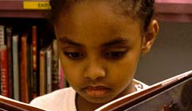
The flagship public television and radio station in the nation's capital
WETA Learning Media
Notes:
So I’d like to talk today about how we’re using public broadcasting and the Web to serve a mission that we share with everyone in this room: to provide the best, most compelling information about giving every child the best possible opportunity to become a skilled and passionate reader and writer.
RR based at PBS—consciously created a new model—stay with a field for a long time, get to know partners, etc. Build an audience based on the web, with TV as a billboard for the project.
I’ll spend a few minutes letting you know what we do, and then talk about something equally important: how we have built our audience.

Slide 2
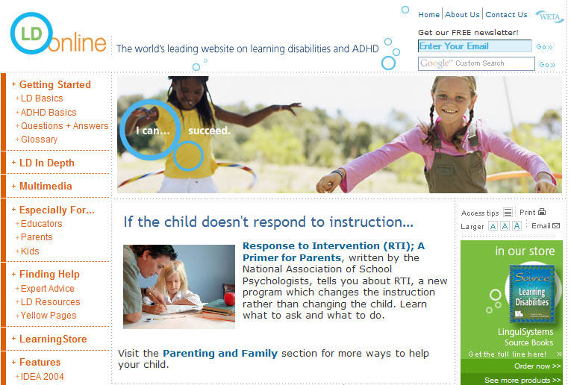
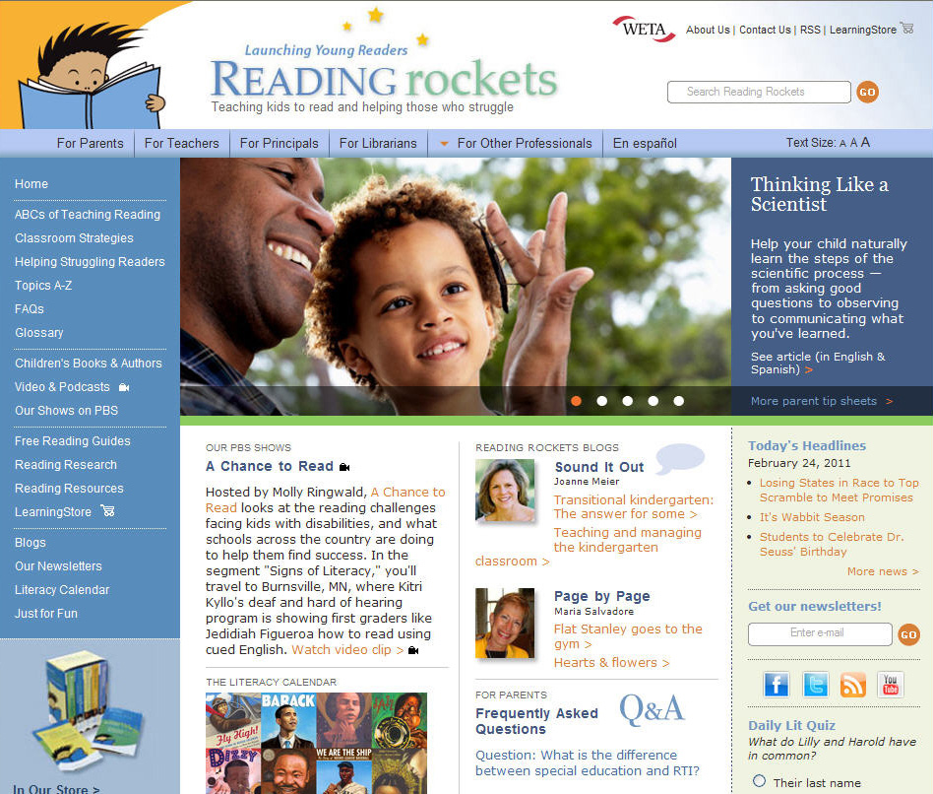
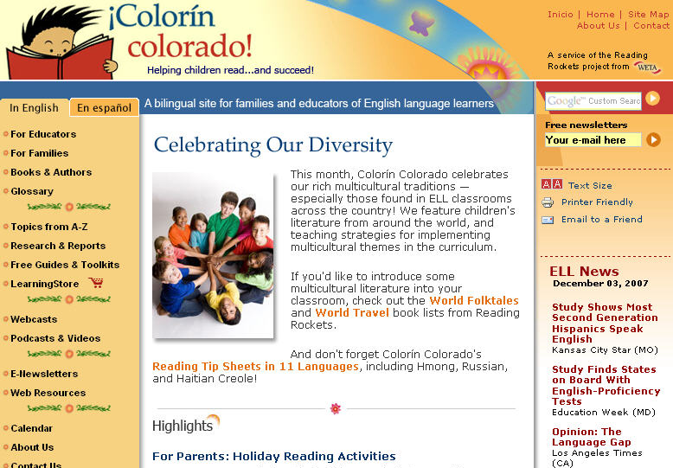
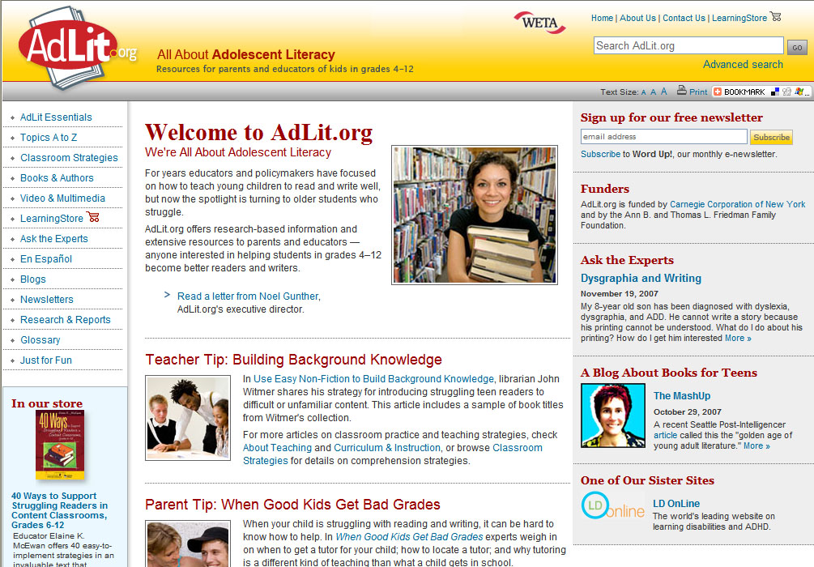
WETA Learning Media
Our Education Projects
Notes:
Since starting the department about 10 years ago, we have created, in effect, four new channels: Reading Rockets, LD OnLine, Colorin Colorado, and, most recently, AdLit.org.
Starting from scratch, we’re producing programs for PBS. We’re building national brands on the Web that now serve more than 500,000 unique visitors each month. We publish electronic newsletters that reach more than 170,000 subscribers. And most important, we’ve managed to take some complex subjects and present them in a way that’s accessible to the average teacher, the average principal, the average parent. We’ve created, I think, a powerful model of public education on a national scale.

Slide 3
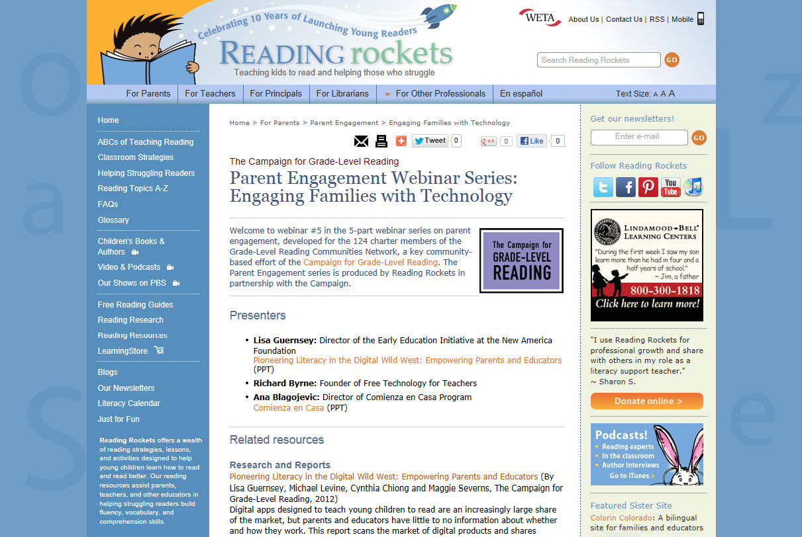

Slide 4
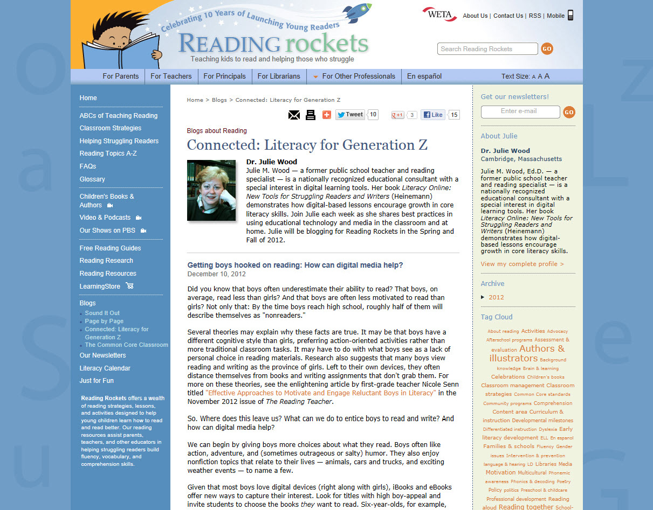

Slide 5
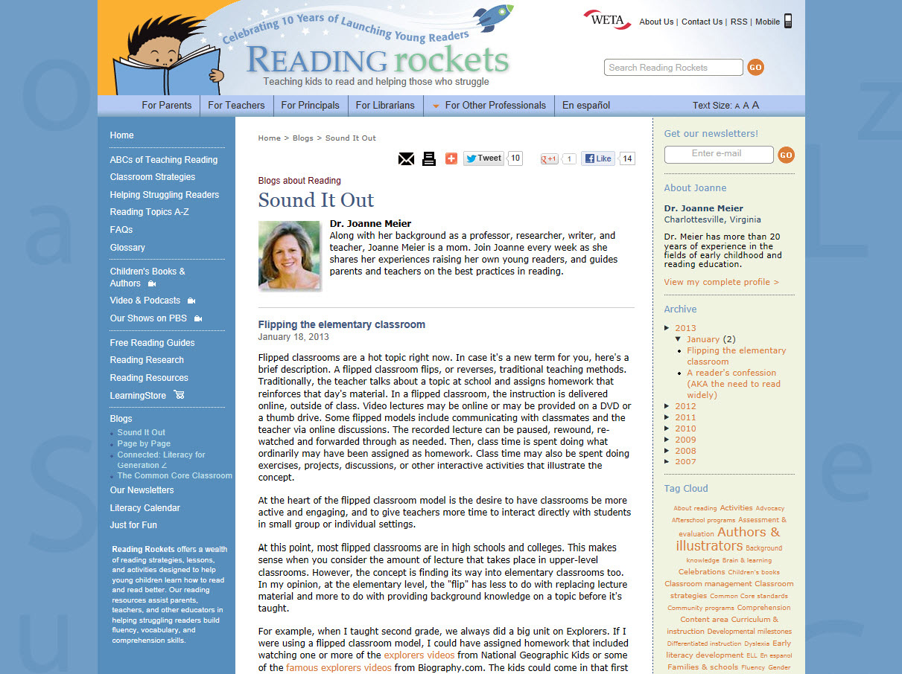

Slide 6
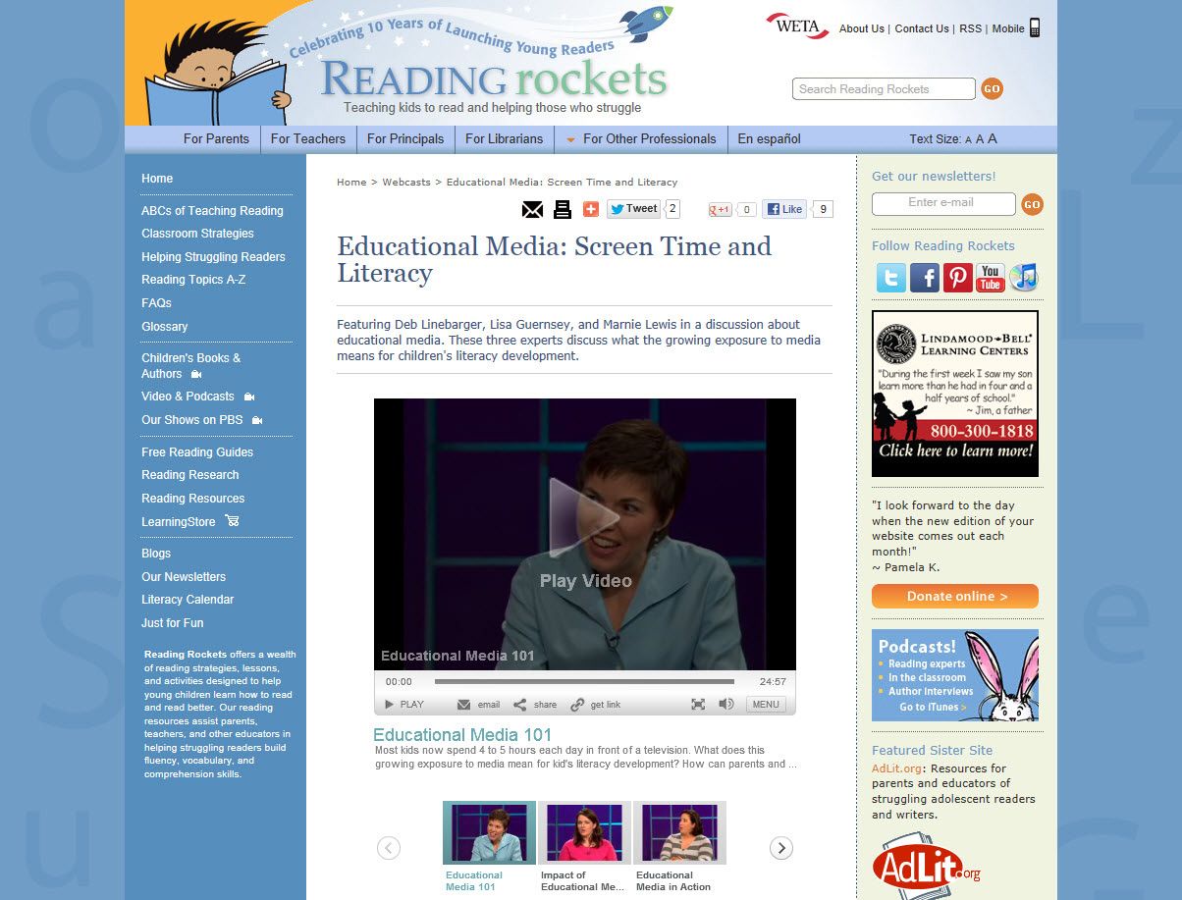

Slide 7
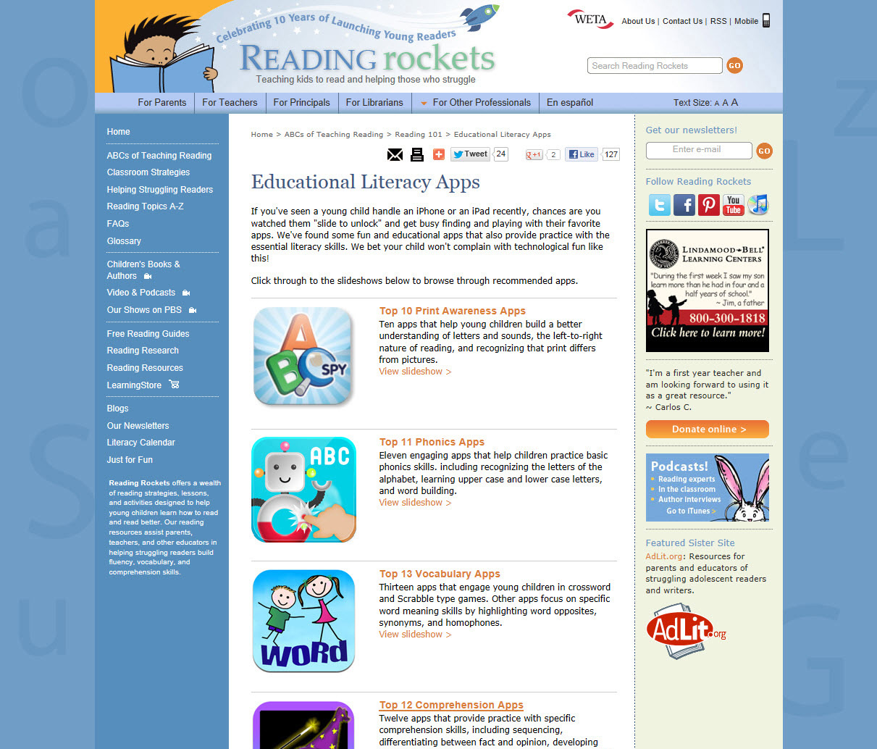

Slide 8
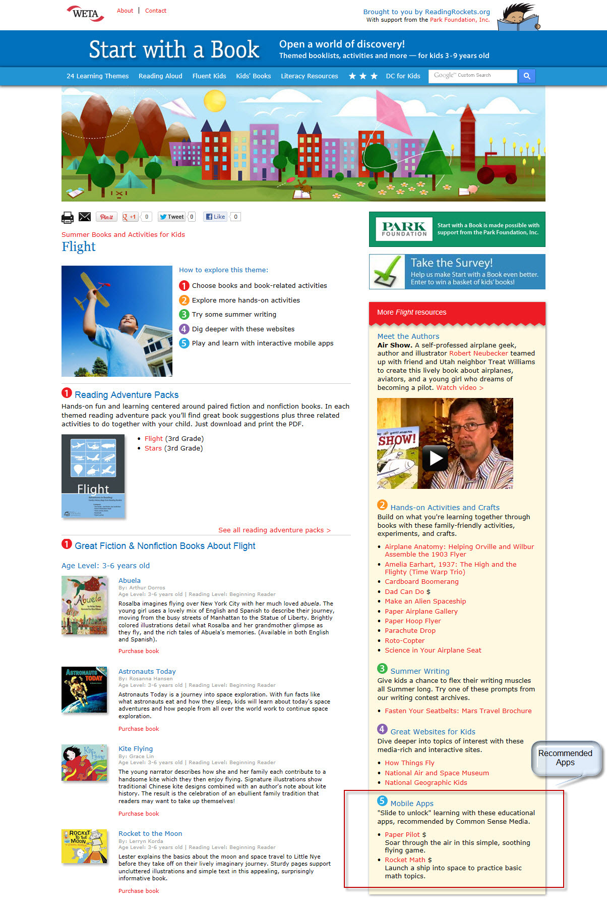

Slide 9
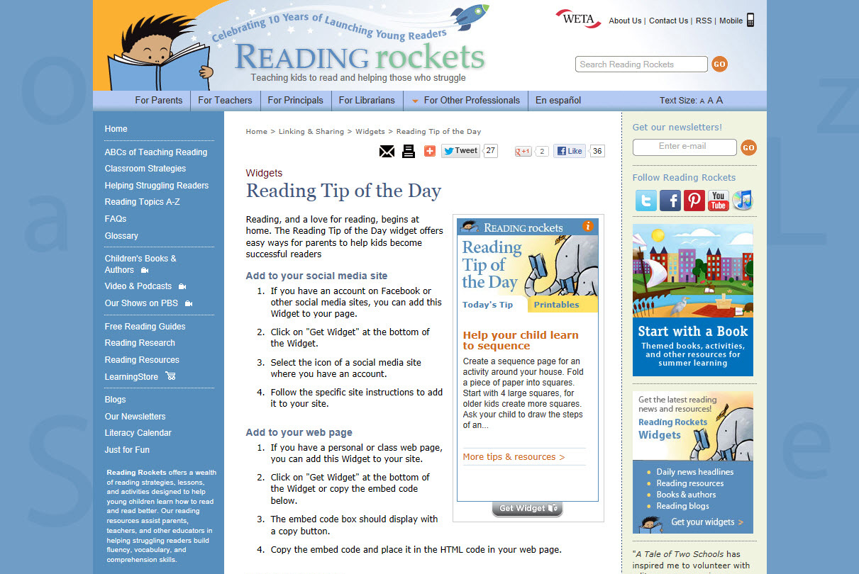

Slide 10
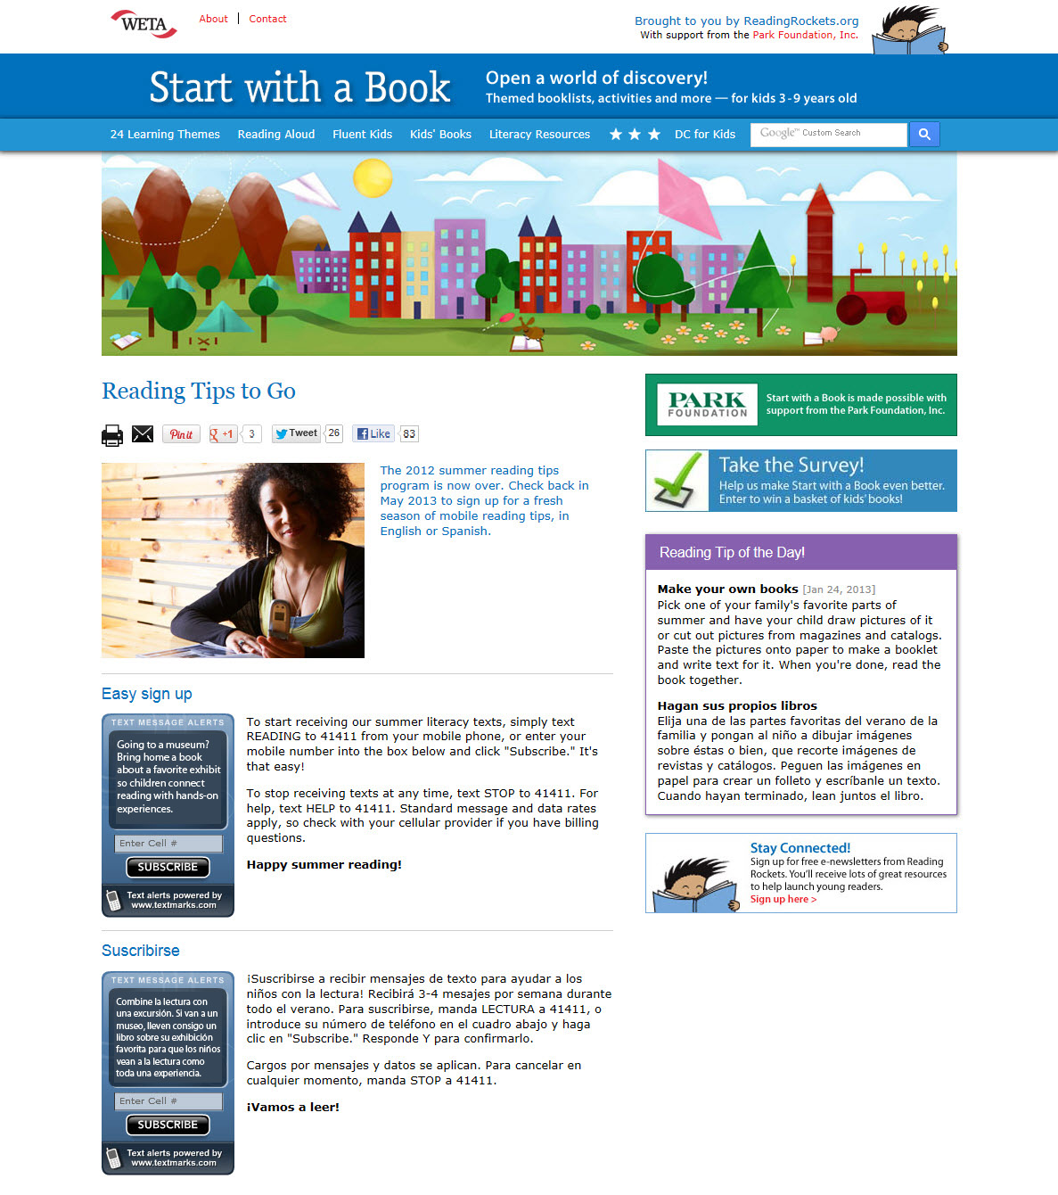

Slide 11
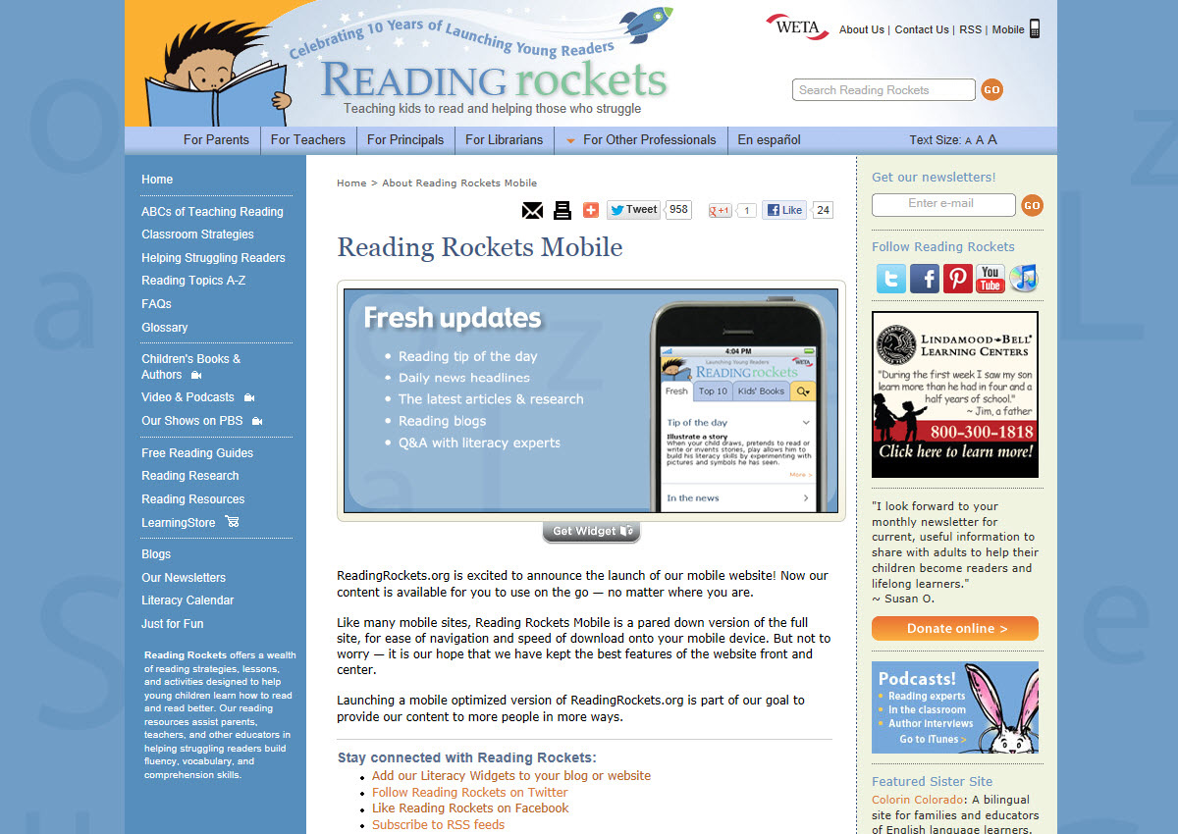

Slide 12
