Slide 1
About Us:
Family Foundation
3 Areas of Funding
Funding for 20 Years

Slide 2
DON’T
“DYS”
OUR KIDS
DYSLEXIA AND THE QUEST FOR GRADE LEVEL READING PROFICIENCY
Emily Hall Tremaine Foundation
www.tremainefoundation.org
Nov. 14, 2012 Don’t Dys Our Kids Webinar

Slide 3
“Don’t Dys Our Kids”
Co-funded by Annie E. Casey Foundation and the Campaign for Grade Level Reading; written by Leila Fiester
Process: Consultative Sessions, Interviews, Literature Review
Purpose: Make the Case for Connecting Efforts of LD Community AND the Reading\Literacy Community
www.tremainefoundation.org

Slide 4
What is LD?
2.4 million students in the US have been identified as having a specific learning disability
SLD effects students in every zip code
SLDs are under diagnosed, it is thought that as much as 20% of our population has dyslexia

Slide 5
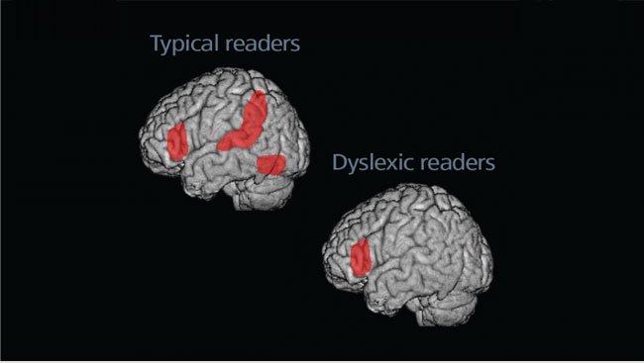
Great Minds Don’t Think Alike

Slide 6
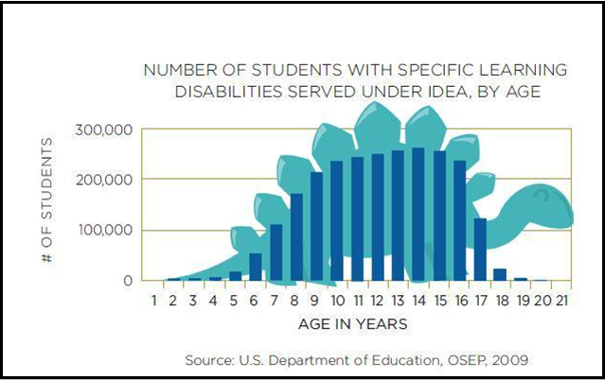
Dinosaur Stomp

Slide 7
Definition:
advocacy - active support of an idea or cause etc.; especially the act of pleading or arguing for something

Slide 8
What is Needed
Helping parents understand what LD is and how it affects their children’s education from an early stage —ideally, as early as preschool
Explaining LD in a culturally appropriate way using terms that parents don’t hear as derogatory or critical of their child’s intellectual ability
Reaching parents through the information sources they know and trust (e.g., the NAACP, Urban League, local food banks, churches, etc.)
Reaching out to parents who may not otherwise be engaged in the school

Slide 9
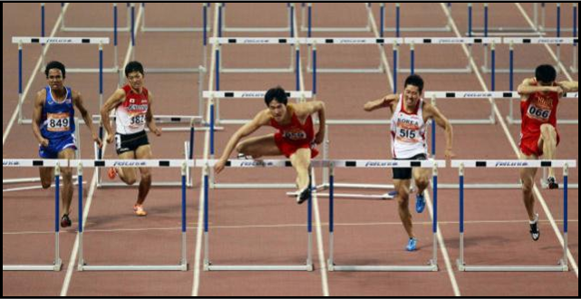
Dyslexia, and Grade Level Reading

Slide 10
School Readiness
Studies have shown that early identification and remediation are key in the success of a child with LD
Parents who are more informed and want their children to be successful in life will recognize early warning signs, often prior to the teacher, and be able to advocate for the remediation their child needs.

Slide 11
Chronic Absence
Students who have dyslexia or are struggling academically tend to have more absences than their peers who are performing at grade level. As understanding is gained and stigma is reduced students will want to attend school.
Students who feel empowered are more apt to face their challenges.

Slide 12
Summer Learning Loss
Students who have LD tend to fall even further behind over the summer
Parents can help their children over the summer either at home, or by getting them the services they require through their school or outside agencies

Slide 13
As Harvey Hubbell created his documentary, Dislecksia: the Movie he found that
the 1 thing that every successful dyslexic had in common was a
parent advocate.

Slide 14
Thank you!
Suzanne Lang
Emily Hall Tremaine Foundation
www.tremainefoundation.org
November 29, 2012

