Slide 1

Family Advocacy
Why is it important?
How can we deepen family involvement to develop advocacy?
What types of supports are most effective?
Family tips
Provider tips

Slide 2
Family involvement is grounded in laws and best practices
Increased emphasis of family and student involvement in No Child Left Behind (NCLB) and Individuals with Disabilities Education Act (IDEA)
Providers need to be clear that family involvement is the goal. Try to eliminate “parent” from our vocabulary unless an actual parent’s involvement is legally required.

Slide 3
Successful advocacy is based on building relationships
Families who develop partnerships with providers will be more effective in securing appropriate services and supports for their children.
Economic impact on schools and families are drastic: disinvestment in education and housing. Families and school personnel are struggling.

Slide 4
How to maximize the effectiveness of your efforts
A presentation or lecture has a limited effect.
Training plus demonstrations of concepts and practice will provide significant gains in knowledge and skills, but only 5% behavior change.
In order to best impact
people’s behavior, you need to
implement supports, such as
coaching and feedback.

Slide 5

How to provide good coaching
Coaching for individual change focuses on:
  Capacity development,
  Feedback and
  Emotional support
  (e.g., encouragement,
  sounding board)
Can be provided by trained
peers, and is best when
it is both consistent and adaptable.

Slide 6
Top 10 tips for families
Talk with your child about the value of education
Speak up for your child’s needs, develop relationships with providers
Act, don’t wait
Ask questions
Don’t sign anything that
you have questions about
or don’t agree with

Slide 7
Top 10 tips for families, continued
6. Support your child to make choices and speak out for him/herself
7. Keep good records
8. Help your child to have strong connections with school and positive activities
9. Work with others to improve children’s services
10. Strive for balance

Slide 8

Tips for Parent-Teacher meetings
First, try to talk with your child and think of questions
At the meeting, ask questions and share your ideas:
a. Ask what the teacher knows about your child.
b. Ask what the teacher expects students to learn, and how s/he runs the class (including testing, assignments, homework, etc.).
c. Ask what you can do to help your
child succeed.
d. Ask what your child can do if s/he
needs extra help.
e. Talk with the teacher about what
you expect and hope for your child.

Slide 9

Communication
Give respect, expect to receive respect
You are an expert about your child
Avoid accusations and aggression; express needs assertively
Use “I statements”
Accept responsibility for
what you can do to provide
support and follow-through
Listen and learn

Slide 10
Tips for providers for program success
a. Relationships matter
b. Dismantle barriers to your
efforts
c. Provide supports and
incentives
d. Respect parents as the experts on their own children
e. Communicate hope and high expectations
f. Model good advocacy/communication

Slide 11
User-friendly writing
Best to write at a 5th grade reading level
(Example: the JustChildren handbook “Helping You Help Your Child” available on the Legal Aid Justice Center website, right click to open hyperlinks:
In English:
http://www.justice4all.org/sites/default/files/Helping%20You%20Help%20Your%20Child%205th%20Edition.pdf
In Spanish: http://www.justice4all.org/sites/default/files/AYUDANDOLE%20A%20AYUDAR%20A%20SU%20HIJO_0.pdf)
Test the readability of your documents:
  Click away…
  Review on toolbar 2. Spelling and grammar
  3. Options 4. Okay
  5. Show readability statistics (approximately the 10th checkbox)
  Then run spell check. After spell check is completed, a box with readability data will appear.

Slide 12

Students with Disabilities
Each person is unique
Children with disabilities are more like other children than they are different
Special education laws (Birth - age 22) and adult service systems recognize individual needs, but resources are limited
IDEA includes rights for early intervention services (age birth to 3): Individualized Family Service Plan and Special Education services: Individual Educational Programs (IEPs)

Slide 13

A bit more about special education services
Special education services are governed by IDEIA: The Individuals with Disabilities Education Improvement Act
FAPE: Free, appropriate public education
1. Appropriate evaluation
2. Individualized education program
3. Least restrictive environment (the only
option leading to full graduation)
4. Parent/student participation in decision-
making
5. Procedural safeguards (dispute
resolution, rights as a team member)

Slide 14
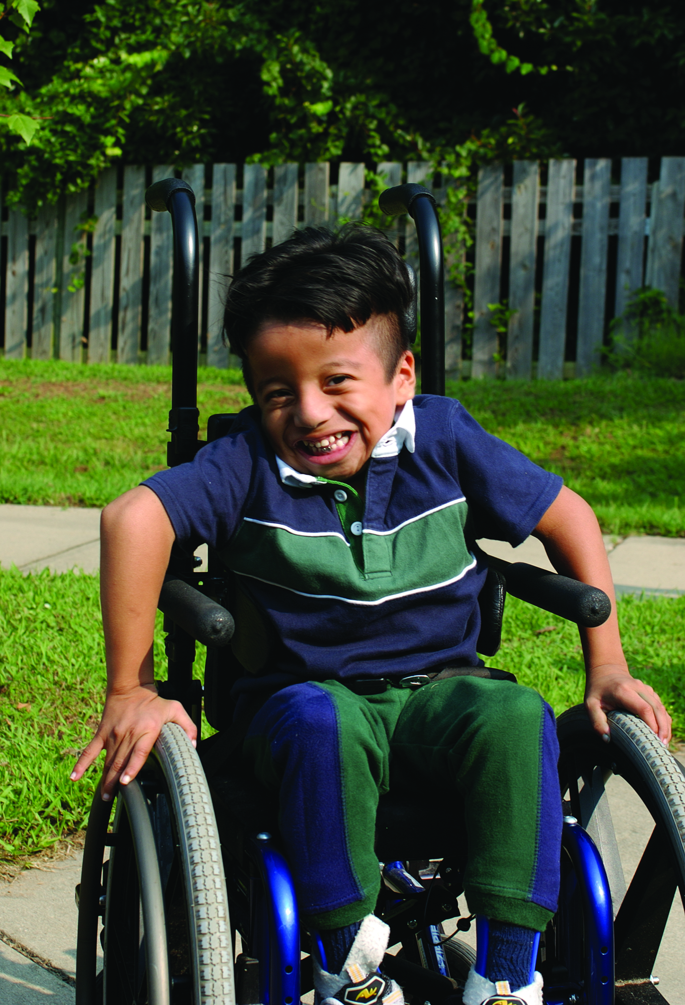
Supportive Services
Service coordination (often through state-funded mental health services organization)
Waiting lists for housing
Recreation, respite
Employment and
pre-vocational programs
Home and community-based
waivers (Medicaid programs)

Slide 15
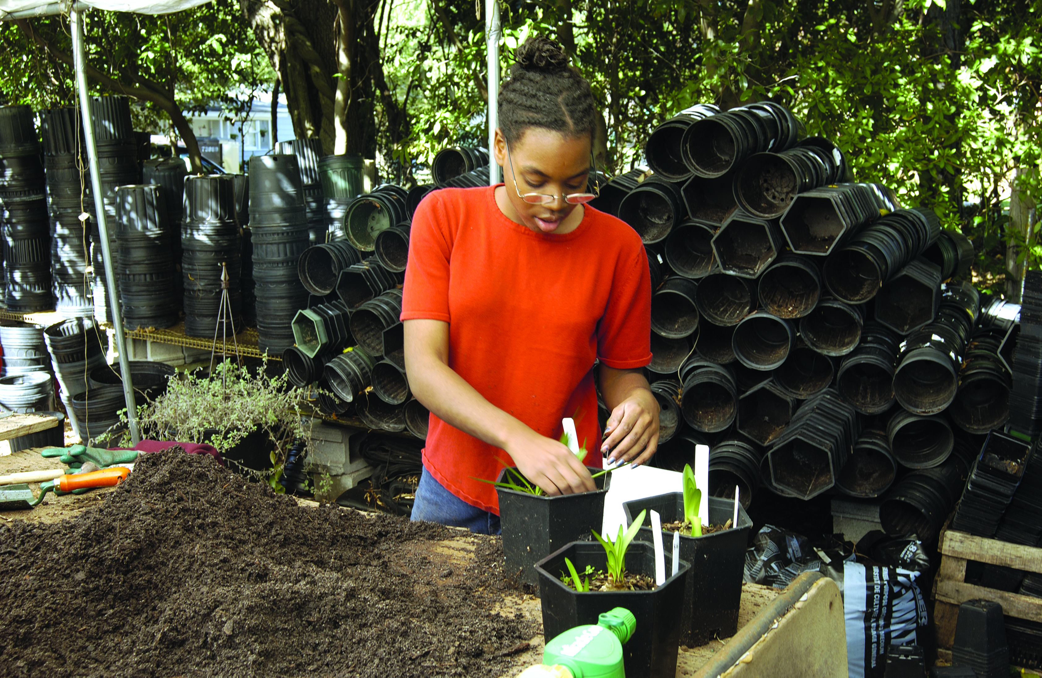
Helping students stay on track
In Virginia, each new high school graduate represents: $111,586 in direct cost savings, and $582,000 in total social and fiscal benefits. High school graduates earn approximately $1 million more over the course of their lives. Improving school climates and reducing overly harsh discipline increases graduation rates.
Most suspensions are for minor
misconduct.
Advocacy is critical for
children who are excluded
from school.

Slide 16
Thank you
Thank you for participating today and good luck with your work!
Emily Dreyfus,
JustChildren Community Education and Outreach Director
Legal Aid Justice Center
1000 Preston Avenue, Suite A
Charlottesville, VA 22903
(434)977-0553 X109
emily@justice4all.org
www.justice4all.org

