Slide 1
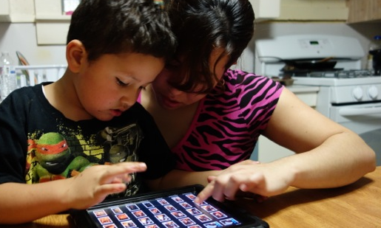
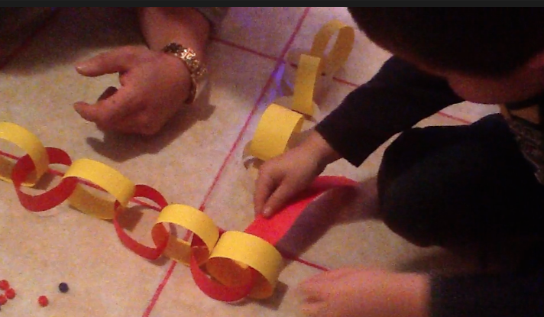


Comienza en Casa
It Starts at Home
Ana Blagojevic, Mano en Mano|Hand in Hand
Maine Migrant Education Program

Slide 2
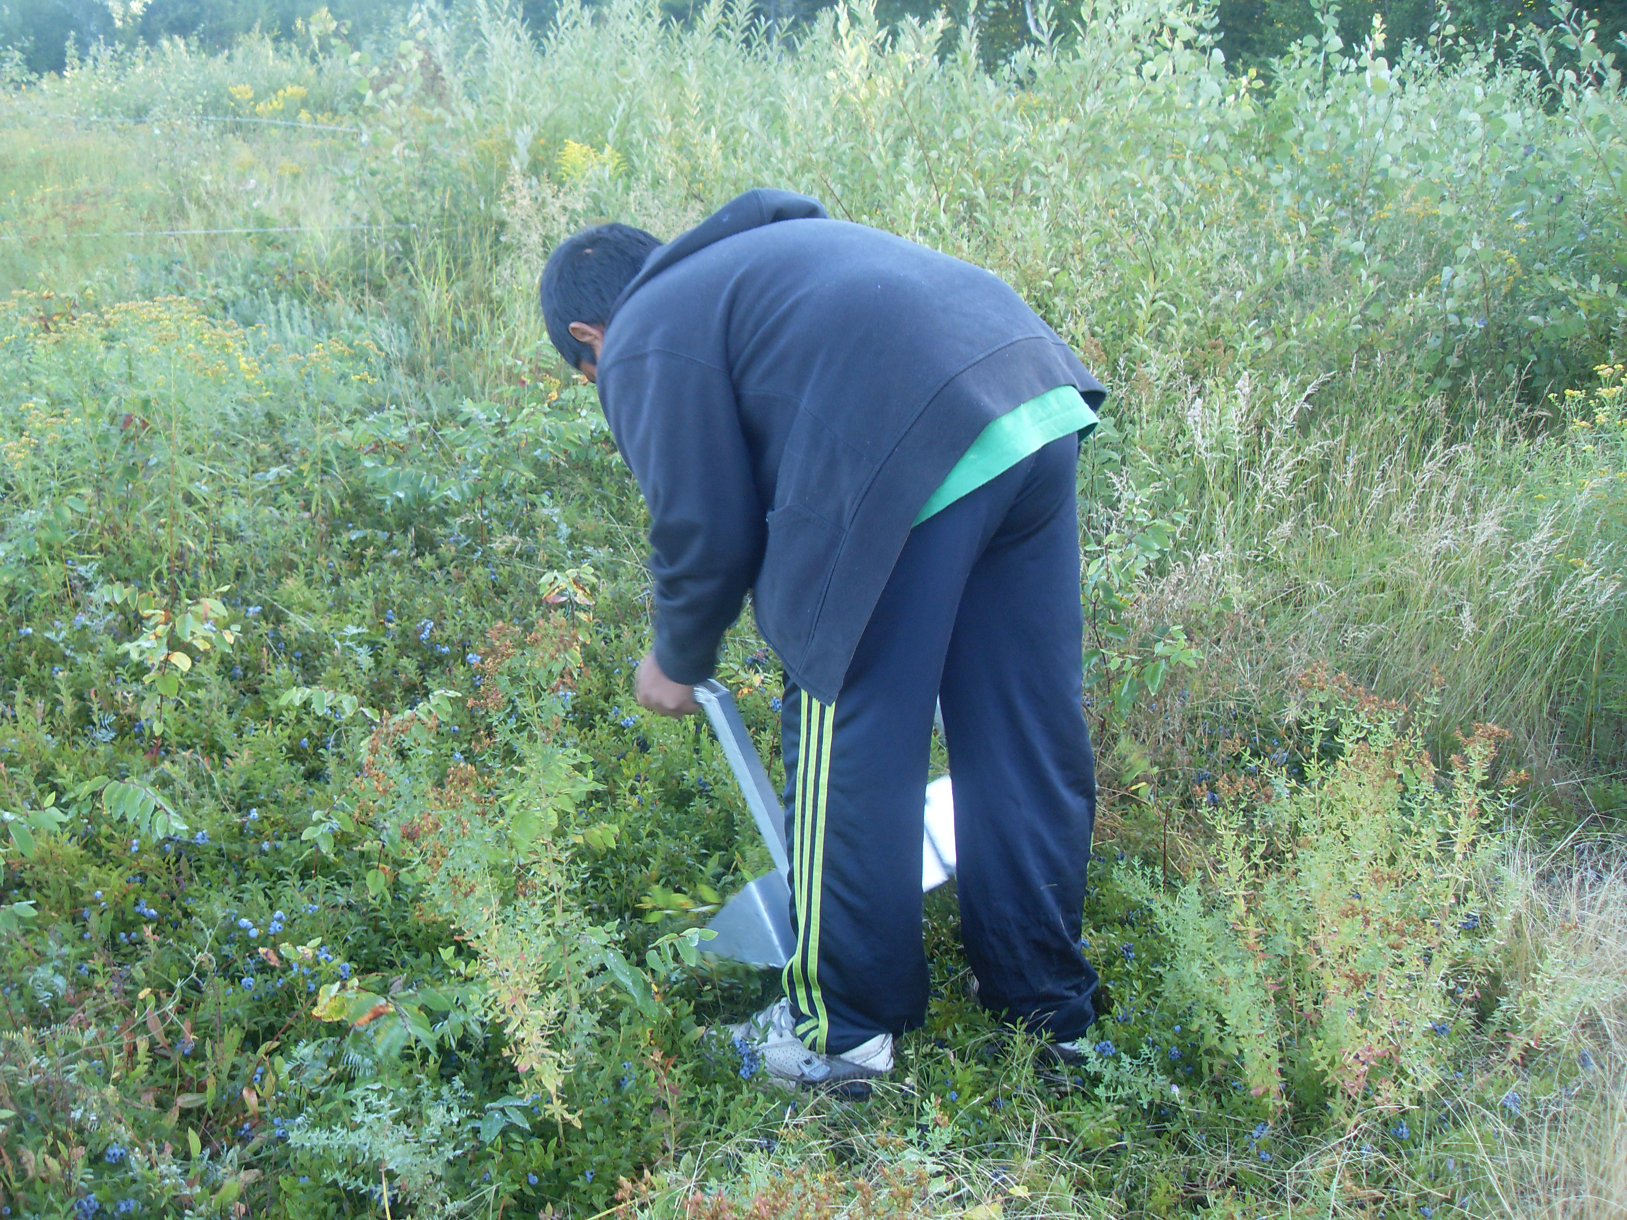
Community Background
Milbridge, ME: population 1,353
  Milbridge Elementary (K-8) 115 students and 15 ESL students
Migrant population working in blueberry harvesting, sea cucumber processing and wreath making
Families in the project
  Spanish as home language
  Parents coming from Mexico
  Variety of educational backgrounds
  Migrant Farmworkers

Slide 3
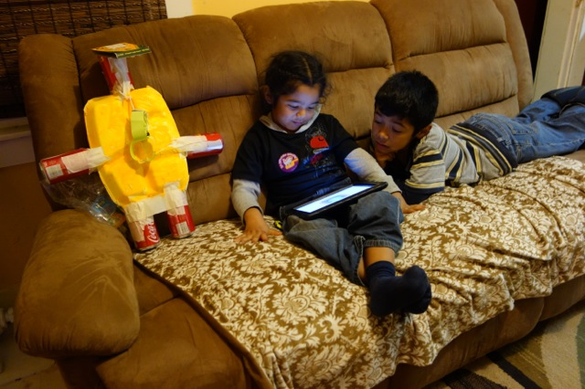
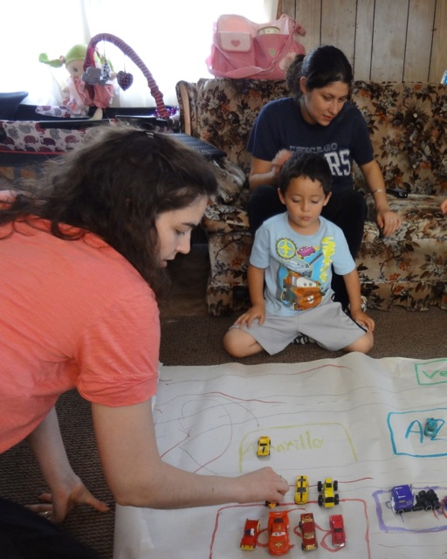
Program Overview
    Program Goal: to engage parents with information and tools that they can use to help their child develop school readiness skills and contribute to his/her success in school and in life.
    Piloted Spring 2012, and redesigned for Fall 2012
    4 families with pre-K/K children participate
    Home-based curriculum combined iPad use and traditional early learning activities

Slide 4
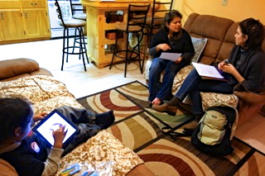
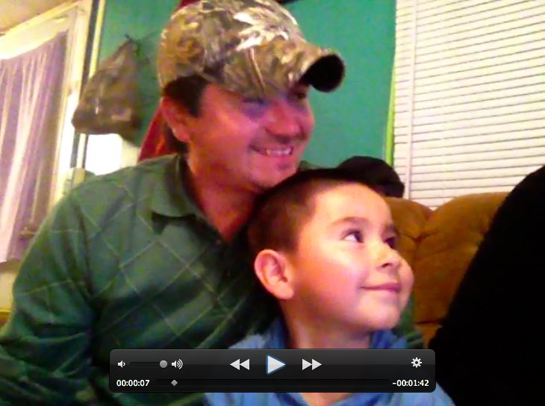
Program Structure
3 units Fall session, 1 unit per month
  Parent meeting to introduce unit
  Mid-unit home visit
  Written/video reflection from
  parents on progress and goals
  *Celebration at end of session

Slide 5
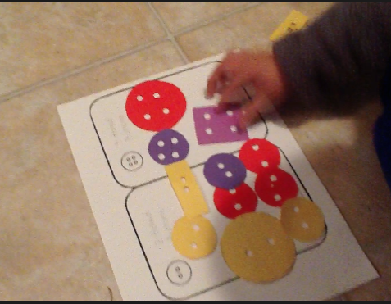
Learning Goals
  Early math and literacy concepts +
  topics traditionally discussed in preschool and kindergarten
  Health and Safety unit example:
Math concepts:
  Counting one to ten, begin to understand that the last counting word means how many
  Name shapes
Health and Safety:
  October-fire safety month
  Emotions-naming, recognizing and know how to negotiate emotions

Slide 6
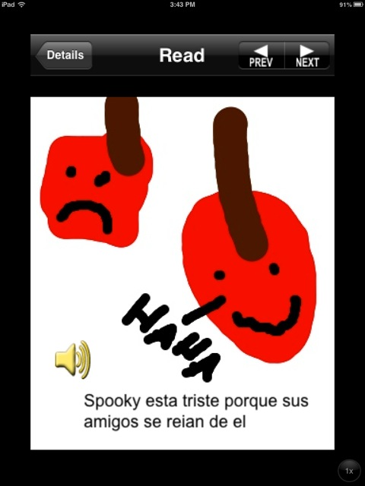
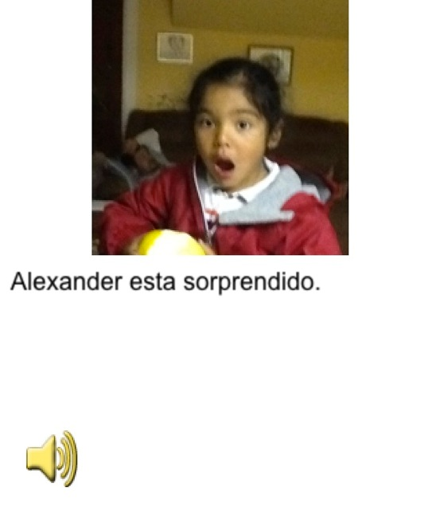
Unit framework: Health and Safety
  Read: The Legend of Spookley, the Square Pumpkin *Pete the Cat and His Four Groovy Buttons
  Play: Counting Bear, Fire Rescue, Emotions, Shapes and Puzzles
  Create: Use Storykit to make your own feelings book
  Off-Screen: Feelings Calendar Report, Button Sorting (shape, color, number of holes)
  Additional Info: Shapes in the Kitchen,How True are Our Assumptions about Screentime? Excerpt
Parent Quote:
“It was good because there was: to read, to play, to do other things, so he’s working on the same thing but in different ways.”

Slide 7
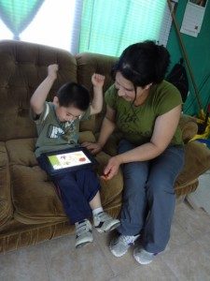
iPad Orientation
New piece of technology
  opportunity to frame the iPad as a learning tool
  strong support for parents to get comfortable with iPad
Focus on parent-child interaction
  Focus on parents understanding learning goals not just supplying them with resources/technology

Slide 8
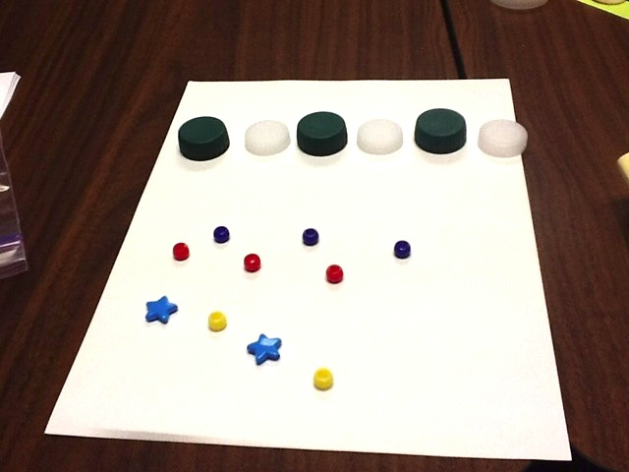
Hands-On Learning
  Essential parents feel comfortable, own it before taking it home
    modeled concepts
    try activities and apps

Slide 9
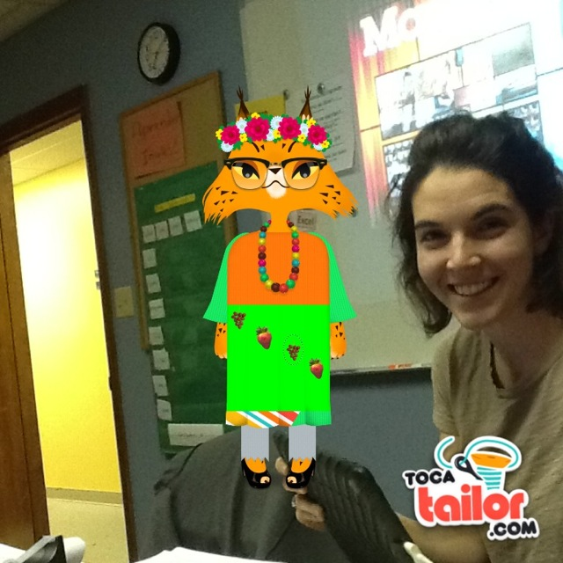
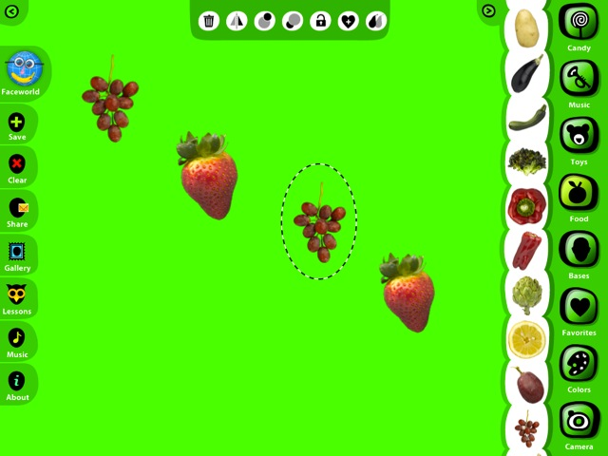
Incorporate Play
Parents used the stamps in the App “Faces I Make” to create a pattern and then imported the image into “Toca Tailor”

Slide 10
Empowering Parents
Support Parents
Help parents understand
what skills/concepts child will need and why they’re important
Gain competency/confidence using technology and off screen activities
Parents support children
Engage, guide and practice concept with child
  Use camera/video to document/observe
  Create storybooks
  Point out concepts from apps in real world --patterning, rhyming, shapes
Parent Quote
“For us to be able to do this we had to not be doing anything else and turn off the television, we had to be paying special attention to what he was doing to help him to focus.”

Slide 11
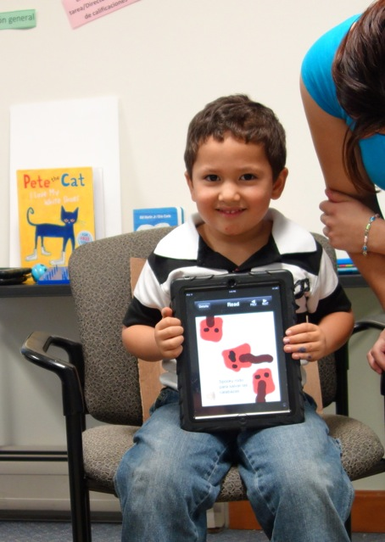
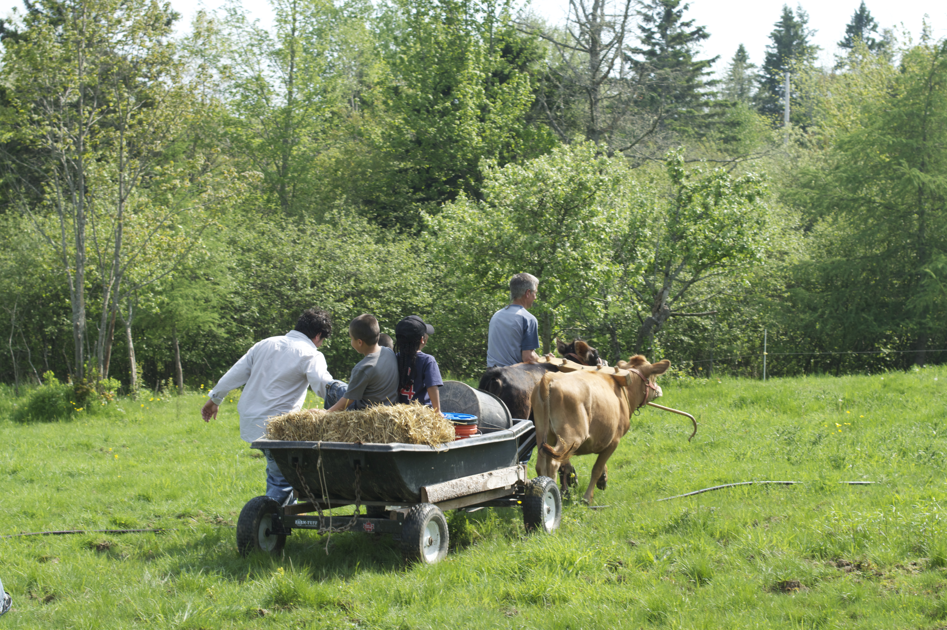
Thank You!
For more information, check out our website:
comienzaencasa.manomaine.org
Ana Blagojevic
ablagojevic@manomaine.org
207-598-8924

